Slide 1


Slide 2
CTOOD PROJECT
UNIVERSITY ONLINE ADMISSION SYSTEM

Slide 3
PROJECT NUMBER: 17
ROHINI PANDIRI 2100031934

Slide 4
Table of contents
1. Project Statement
2. Abstract
3. Project Description
4. Concepts Required
5. Software and Hardware Requirements
6. Class Diagram
7. Project Code
8. Output Screenshots
9. Conclusion

Slide 5
ABSTRACT
University admission system project explains about developing a application through which students from different locations can access university information and take admissions. Using this system time for application process will be reduced and students who are located geographically can fill admissions forms.
This procedure is called as centralized admission process where there is no use of paper admissions. This software application will work on both internal and external sync procedure and the job will be completed in time and it is also possible to integrate other educational agencies if agreed upon common data format.

Slide 6
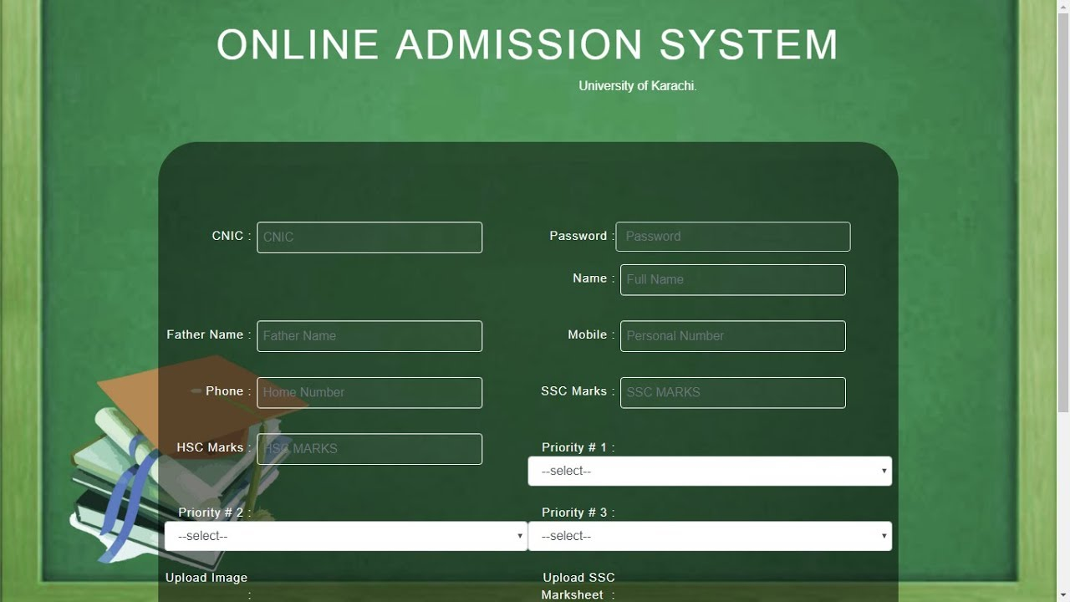

Slide 7
PROJECT DESCRIPTION
The concept is based on the GUI. The idea is to use JAVA SWING AND AWT. Therefore, we need to define all the methods based on functionality. The methods in the program are as follows:
Receipt: The prime functionality of this method is to display all the data that is entered in the text fields, the course to be taken and the final amount that needs to be paid. These operations can be done by adding Action Listeners to the button named as receipt.
Reset: The functionality of this method is to clear the information that is already visible to in the text areas and in the text fields and to add new student’s details and print the fees of that particular student. It can be done by adding Action listeners to the button.
Print: The functionality of this method is to print the fee receipt if the printer is available. We can do this by adding ActionListener to the button. The entire information in the text area is named as area2 and is saved in a file in the computer under the name of java.txt. It will also show a dialog box as Data saved successfully.

Slide 8
CONCEPTS REQUIRED
Files concept
Exception Handling
GUI by importing java awt
OOPs concept like Polymorphism, Encapsulation, Inheritance etc…

Slide 9
SOFTWARE REQUIREMENTS
Runtime – JAVA
Eclipse IDE
GUI – User Interface

Slide 10
HARDWARE REQUIREMENTS
8GB – RAM
512GB – SSD
Windows 11 – OS
I5 - processor

Slide 11
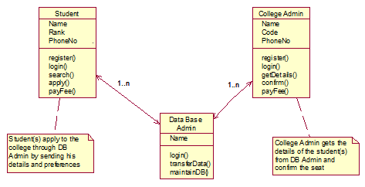
CLASS DIAGRAM

Slide 12
CONCLUSION
Online Admission System supports the administration team and the applicants with the support needed by making the admission process faster, easier and hassle-free experience for all concerned.

Slide 13


